Slide 1

Fuels and stoichiometry

Slide 2

Outline
Composition of fuels
Energy content
Introduction to stoichiometry

Slide 3

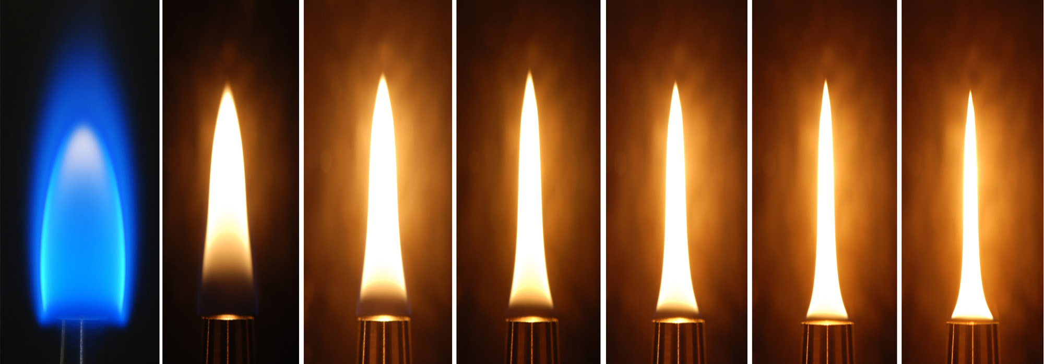

Comparing fuels
Two important considerations:
Fuel value, sometimes called heat value
Carbon emissions
Fuel value – a way of comparing the energy available from the complete combustion of equal masses or volumes of different fuels.
Carbon emission value – compare the amount of carbon dioxide gas produced for a given amount of energy.

Slide 4
Composition of fuels
The amount of carbon in a fuel influences how much energy is released, the amount of oxygen required to do a complete combustion reaction and how much carbon dioxide is produced
Need to be able to calculate the percentage carbon composition of the fuel
We covered calculating percentage composition in a previous presentation

Slide 5
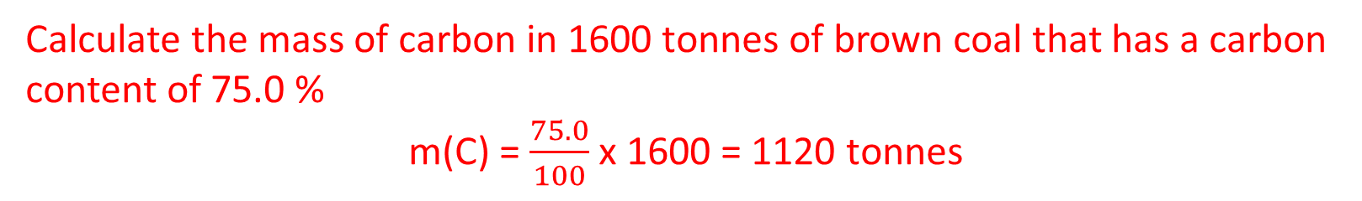
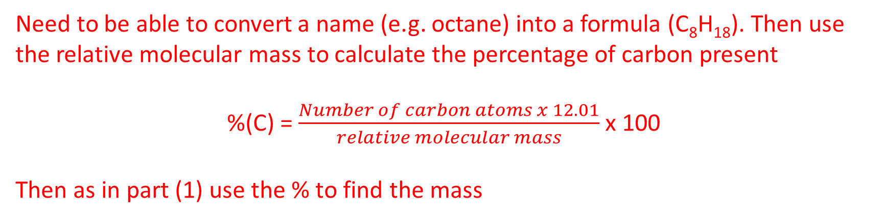
Composition of fuels
Two types of questions:
Carbon content in coal (or other raw material, e.g. crude oil, natural gas)
The carbon content of pure compounds
Calculate the mass of carbon in 1600 tonnes of brown coal that has a carbon content of 75.0 %
m(C) = $\frac{75.0}{100}$ x 1600 = 1120 tonnes
Need to be able to convert a name (e.g. octane) into a formula (C₈H₁₈). Then use the relative molecular mass to calculate the percentage of carbon present
%(C) = $\frac{Number of carbon atoms x 12.01}{relative molecular mass}$ x 100
Then as in part (1) use the % to find the mass

Slide 6
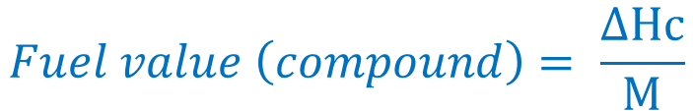
Energy content– Fuel values
Fuel value for a pure compound can be calculated from the standard heat of combustion for the fuel, ΔHc, and the molar mass, M, of the fuel
$$Fuel value \left(compound\right)= \frac{ΔHc}{M}$$
Units: kJ g⁻¹
but also other units e.g. MJ kg⁻¹, MJ L⁻¹
ΔHc = standard heat of combustion of 1 mol of the fuel
M = molar mass of the fuel
However, most fuels are mixtures, so it is more accurate to determine ΔHc experimentally.
Higher fuel values means handling less mass of fuel for the same energy output.

Slide 7

Energy content– Fuel values
It can also be useful to calculate the amount of energy released per mole of pure fuel
Recall - that we can use n = m/M to convert between mass and moles of compound using the molar mass (which we can calculate using the periodic table and the relative atomic mass of the elements)
Energy released $=n x ΔHc$
Units: kJ
ΔHc = standard heat of combustion of 1 mol of the fuel
M = molar mass of the fuel

Slide 8

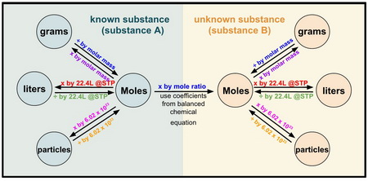
Stoichiometry
Stoichiometry – pronounced “Stoy-KEE-om-Metry”
Stoichiometry is the study of the relationship between the amounts of each reagents in a chemical reaction.
We will look at how we use a balanced chemical equation to determine the relative amounts of reagents and products involved in the reaction. This will require calculations involving:
Mole to mole calculations
Mass to mole calculations
Mole to particle calculations

Slide 9
Stoichiometry – Balancing chemical equations
The first step is to write and balance the chemical equation – For an in-depth review see the presentation on Onenote “Balancing chemical equations” (this is considered as essential prior knowledge.
Steps to balancing a chemical equation:
If you are given a word equation, convert this into a formula equation
Count the number of atoms on each side of the equation
Adjust the numbers by changing the coefficients in front of the substances until the atom count on each size balances

Slide 10

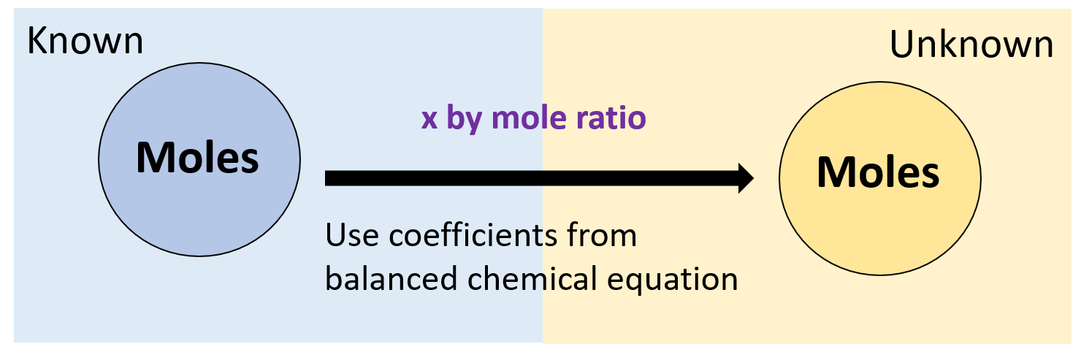
Stoichiometry – crossing the Mole bridge

Slide 11
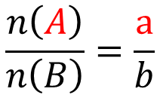
Stoichiometry – mole ratios
A general representation of a chemical equation:
aA + bB → cC + dD
A, B, C, D = the substances in the reaction
a, b, c, d = the reaction coefficients
Moles of A in the reaction
coefficient of A in the reaction
=
Moles of B in the reaction
coefficient of B in the reaction
$$\frac{n\left(A\right)}{n\left(B\right)}=\frac{a}{b}$$

Slide 12

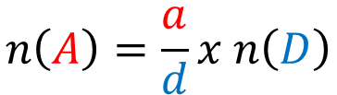
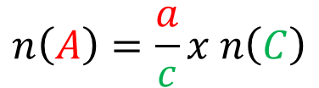
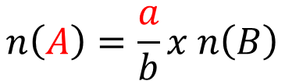
Stoichiometry – mole ratios
aA + bB → cC + dD
$$\frac{n\left(A\right)}{n\left(B\right)}=\frac{a}{b}$$
If we know the moles of A, we can calculate the moles of B
Rearranging this formula gives us a ways to calculated unknown amounts from known amounts:
$$n\left(A\right)=\frac{a}{b}x n\left(B\right)$$
or
$$n\left(A\right)=\frac{a}{c}x n\left(C\right)$$
or
$$n\left(A\right)=\frac{a}{d}x n\left(D\right)$$
In this way we can calculate the amount of all the components of a reaction as long as we have the balance equation and know the amount of one substance

Slide 13
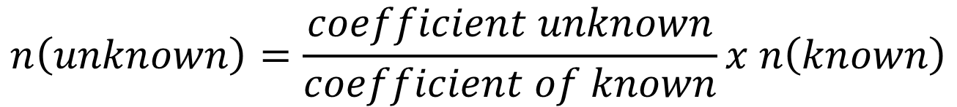
Stoichiometry – mole ratios
This can be simplified to the following relationship:
$$n\left(unknown\right)=\frac{coefficient unknown}{coefficient of known}x n\left(known\right)$$

Slide 14
Stoichiometry – mole ratios
Practice question:
Magnesium reacts with hydrochloric acid according to the following balanced chemical equation:
If two moles of Hydrochloric acid react with excess Magnesium, how many moles of hydrogen gas are produced?
Mg_{(s)} + 2 HCl_{(aq)} → MgCl_{2(aq)} + H_{2(g)}

Slide 15
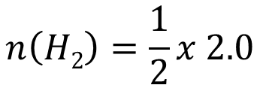

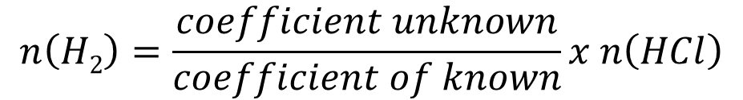
Stoichiometry – mole ratios
Magnesium reacts with hydrochloric acid according to the following balanced chemical equation:
If two moles of Hydrochloric acid react with excess Magnesium, how many moles of hydrogen gas are produced?
Mg_{(s)} + 2 HCl_{(aq)} → MgCl_{2(aq)} + H_{2(g)}
n(HCl) = 2.0 mol
n(H₂) = ?
$$n\left(H2\right)=\frac{coefficient unknown}{coefficient of known}x n\left(HCl\right)$$
$$n\left(H2\right)=\frac{1}{2}x 2.0$$
$$n\left(H2\right)=1.0 mol$$

Slide 16
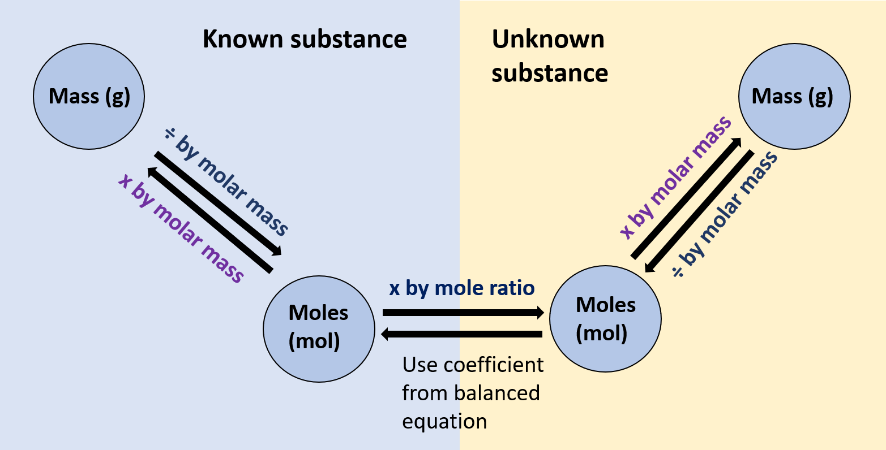
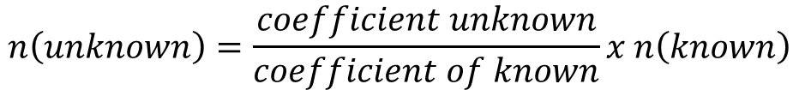

Stoichiometry – mass to mass
$$n= \frac{m}{M}$$
$$n\left(unknown\right)=\frac{coefficient unknown}{coefficient of known}x n\left(known\right)$$
Relevant equations:

Slide 17
Stoichiometry – mass to mass
Practice Question:
In a reaction, 50.0 g of manganese(IV) oxide reacts with excess aluminum. Calculate the mass of manganese metal produced.
3 MnO_{2(s)} + 4 Al_{(s)} → 3 Mn_{(s)} + 2 Al₂O_{3(s)}

Slide 18


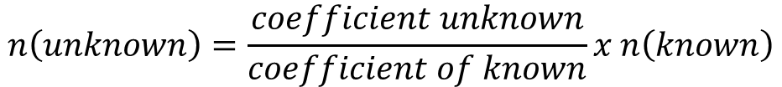
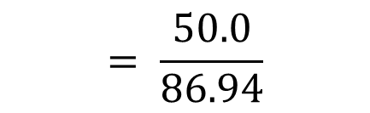



Stoichiometry – mass to mass
3 MnO_{2(s)} + 4 Al_{(s)} → 3 Mn_{(s)} + 2 Al₂O_{3(s)}
50.0 g
m =?
$$= \frac{50.0}{86.94}$$
$$n= \frac{m}{M}$$
m(MnO₂) = 50.0 g
n(MnO₂) = ?
M(MnO₂) = 86.94 g mol⁻¹
n(MnO₂) = 0.575 mol
n(Mn) = ?
$$n\left(unknown\right)=\frac{coefficient unknown}{coefficient of known}x n\left(known\right)$$
$$n\left(Mn\right)=\frac{3}{3}x 0.575$$
$$n\left(Mn\right)=0.575 mol$$
m(Mn) = ?
$$m=n×M$$
M(Mn) = 54.94 g mol⁻¹
$$=0.575×54.94$$
m(Mn) = 31.6 g
31.6 g of manganese would be produced

Slide 19
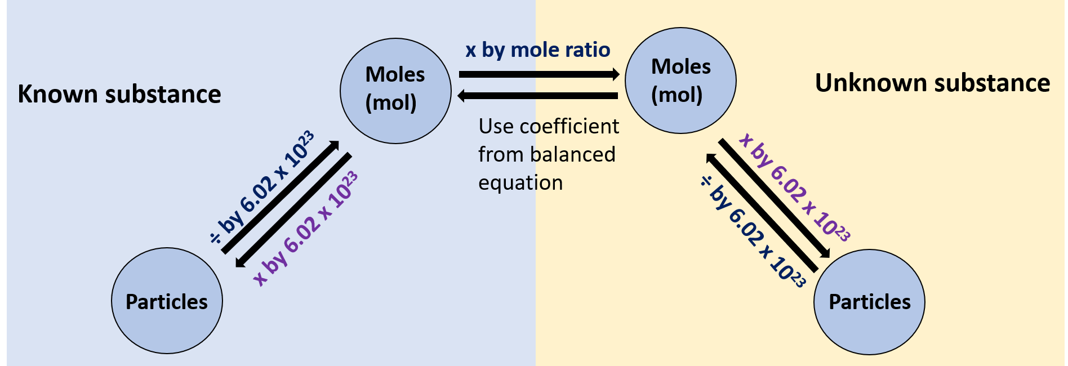

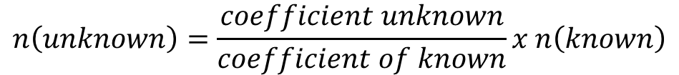
Stoichiometry – particles to particles
Relevant equations:
$$n=\frac{N}{\text{6.022 }\text{x}\text{ 1023}}$$
$$n\left(unknown\right)=\frac{coefficient unknown}{coefficient of known}x n\left(known\right)$$

Slide 20
Stoichiometry – particles to particles
Practice Question:
How many molecules of carbon disulfide will react with 4.21 x 10¹⁹ molecules of oxygen at STP?
___ CS₂ + ___ O₂ → ___ CO₂ + ___ SO₂

Slide 21









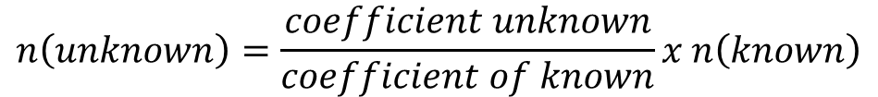

Stoichiometry – particles to particles
3
2
___ CS₂ + ___ O₂ → ___ CO₂ + ___ SO₂
?
molecules
4.21 x 10¹⁹
molecules
$$n=\frac{N}{\text{6.022 }\text{x}\text{ 1023}}$$
$$N\left(O2\right)=4.21 x 1019$$
$$n\left(\text{O}\text{2}\right)= ?$$
$$=\frac{4.21 x 1019}{\text{6.022 }\text{x}\text{ 1023}}$$
$$n\left(\text{O}\text{2}\right)=$$
6.99 x 10⁻⁵ mol
$$n\left(\text{CS}\text{2}\right)= ?$$
$$n\left(unknown\right)=\frac{coefficient unknown}{coefficient of known}x n\left(known\right)$$
$$n\left(\text{CS}\text{2}\right)=\frac{1}{3}x \text{6.99 }\text{x}\text{ 10−5}$$
= 2.33 x 10⁻⁵ mol
$$N\left(CS2\right)= ?$$
$$N=n x \text{6.022 }\text{x}\text{ 1023 }$$
$$=\text{1.40} \text{x}\text{ 1019 }$$
molecules of CS₂

Slide 22
Known substance
Unknown substance
Stoichiometry – summary
Mass (g)
Mass (g)
x by molar mass
÷ by molar mass
÷ by molar mass
x by molar mass
x by mole ratio
Moles (mol)
Moles (mol)
Use coefficient from balanced equation
÷ by 6.02 x 10²³
x by 6.02 x 10²³
x by 6.02 x 10²³
÷ by 6.02 x 10²³
Particles
Particles

Slide 23
Comparing fuels – Carbon emission values
Carbon emission values usually expressed as the mass of carbon dioxide produced in grams (g) per megajoule (MJ) of energy released when the fuel is burnt.
Carbon emission values in g(CO₂) MJ⁻¹
Considering carbon emission values is important for countries that are signatures to the Kyoto Protocol
Kyoto Protocol – sets binding carbon emission reduction targets for 37 industrialised countries.

Slide 24
Comparing fuels
Type of fuel | Fuel value (heating value) | Carbon emission value
Coal | 24 – 30 MJ kg⁻¹ (black coal) | 90 – 95 g(CO₂) MJ⁻¹
Natural gas | 47 MJ kg⁻¹ | 51 g(CO₂) MJ⁻¹
Liquified petroleum gas | 49 MJ kg⁻¹ | 59 g(CO₂) MJ⁻¹
Petrol | 46 MJ kg⁻¹ | 66 g(CO₂) MJ⁻¹
Diesel | 46 MJ kg⁻¹ | 70 g(CO₂) MJ⁻¹
Coal is the cheapest but has the highest carbon emission value
NG lowest carbon emission value, but is difficult to transport
LPG easier to transport safely but has a lower fuel value per litre (26 MJ L⁻¹) compared to petrol (34 MJ L⁻¹)

Slide 25
Choosing a fuel
Fuel needs to be fit for purpose
Factors to consider:
Energy released per unit mass or volume
Availability and cost of fuel
Ease of transport
Hazards to people and the environment associated with its use and its waste products
Social, economic, cultural and political values that can affect the choice of the fuel

Slide 26

On going work
Pearson 11.3 review and the chapter 11 review
STAWA sets 17 and 18

